Slide 1

Natural Language Processing
Naeemullah Khan
naeemullah.khan@kaust.edu.sa
KAUST Academy
King Abdullah University of Science and Technology

Slide 2
What is NLP?
Study of computational approaches for processing natural languages
Process → acquire, represent, store, understand, characterize, generate, etc
Natural languages → human languages

Slide 3
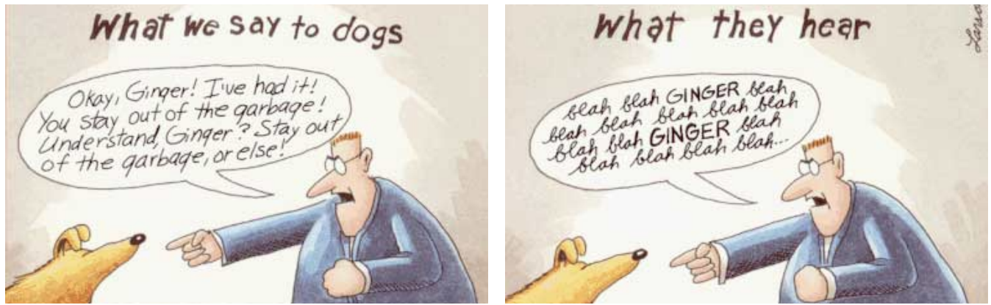
Goal
Goal: Deep Understanding
Requires context, linguistic structure, meanings…
To Avoid: Shallow Matching
Could be useful also though depending on use case

Slide 4
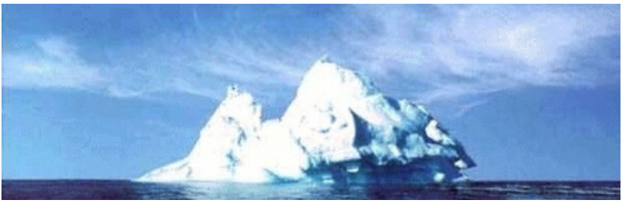
Text Data is Superficial
An iceberg is a large piece of freshwater ice that has broken off from a snow-formed glacier or ice shelf and is floating in open water.

Slide 5
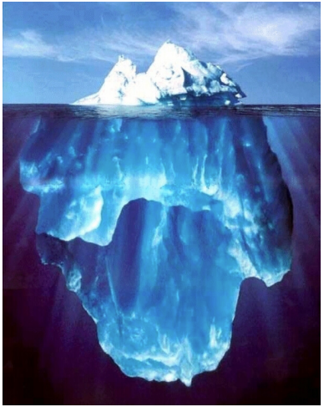
.. But Language is Complex
An iceberg is a large piece of freshwater ice that has broken off from a snow-formed glacier or ice shelf and is floating in open water.

Slide 6
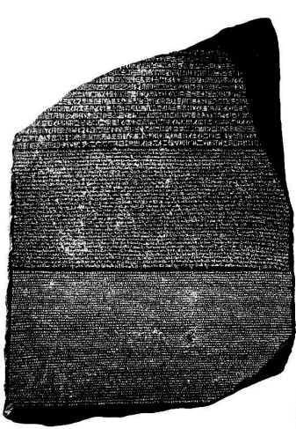
Corpora
A corpus is a collection of text
Often annotated in some way
Sometimes just lots of text
Balanced corpora (usually not possible)
Examples
Newswire collections: 500M+ words
Brown corpus: 1M words of tagged “balanced” text
Penn Treebank: 1M words of parsed WSJ
Canadian Hansards: 10M+ words of aligned French / English sentences
The Web: billions of words of who knows what

Slide 7

Vocabulary
I am happy because I am learning
NLP
Tweets:
[tweet_1, tweet_2, ..., tweet_m]
...
...
...
I hated the movie
[ I, am,
happy,
because,
learning,
NLP,
... hated,
the,
movie ]

Slide 8
Feature extraction
I am happy because I am learning NLP
[ I , am, happy, because, learning,
NLP, ...
hated,
the,
movie ]
[ 1, 1,
1,
1, 1, 1, ... 0,
A lot of zeros! That’s a sparse representation.
0,
0 ]

Slide 9
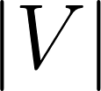
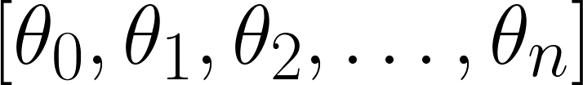

Problems with sparse representations
I am happy because I am learning NLP
[ 1 , 1 , 1 , 1 , 1 , 1 , ... , 0 , … , 0 , 0 , 0 ]
1
All zeros!
Large training
time
Large prediction time

Slide 10
Summary
Vocabulary: set of unique words
Vocabulary, Text [1 ….. 0 ….. 1 .. 0 .. 1 .. 0]
Sparse representations are problematic for training and prediction times

Slide 11
Positive and Negative Frequencies
Populate your vocabulary with a frequency count for each class
Corpus
Vocabulary
I
am
happy
because
learning
NLP
sad
not
I am happy because I am learning
NLP
I am happy
I am sad, I am not learning NLP
I am sad

Slide 12
Positive and negative counts
Positive tweets
Negative tweets
I am happy because I am learning
NLP
I am happy
I am sad, I am not learning NLP
I am sad

Slide 13
Positive and negative counts
Vocabulary
I
PosFreq (1)
Positive tweets
3
3
I am happy because I am learning
NLP
I am happy
am
happy
2
because learning NLP
sad
not
1
1
1
0
0

Slide 14
Positive and negative counts
Vocabulary NegFreq (0)
I
am
happy
because
learning
NLP
sad
not 1
3
Negative tweets
I am sad, I am not learning NLP
I am sad
3
0
0
1
1
2

Slide 15
Word frequency in classes
Vocabulary | PosFreq (1) | NegFreq (0)
I | 3 | 3
am | 3 | 3
happy | 2 | 0
because | 1 | 0
learning | 1 | 1
NLP | 1 | 1
sad | 0 | 2
not | 0 | 1
freqs: dictionary mapping from
(word, class) to frequency

Slide 16
Summary
Divide tweet corpus into two classes: positive and negative
Count each time each word appears in either class
Feature extraction for training and prediction!

Slide 17
Word frequency in classes
Vocabulary | PosFreq (1) | NegFreq (0)
I | 3 | 3
am | 3 | 3
happy | 2 | 0
because | 1 | 0
learning | 1 | 1
NLP | 1 | 1
sad | 0 | 2
not | 0 | 1
freqs: dictionary mapping from
(word, class) to frequency

Slide 18
Feature extraction with frequencies
Extract features from your frequencies dictionary to create a features
vector

Slide 19
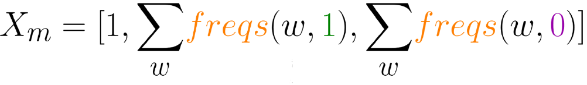
Feature extraction with frequencies
freqs: dictionary mapping from (word, class) to frequency
Features of
tweet m
Sum Pos.
Frequencies
Sum Neg.
Frequencies
Bias

Slide 20
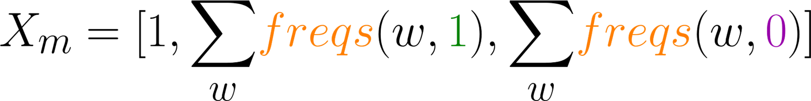
Feature extraction
Vocabulary | PosFreq (1)
I | 3
am | 3
happy | 2
because | 1
learning | 1
NLP | 1
sad | 0
not | 0
I am sad, I am not learning NLP
8

Slide 21
Feature extraction
Vocabulary | NegFreq (0)
I | 3
am | 3
happy | 0
because | 0
learning | 1
NLP | 1
sad | 2
not | 1
I am sad, I am not learning NLP
11

Slide 22
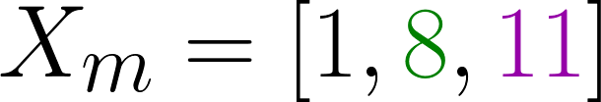
Feature extraction
I am sad, I am not learning NLP

Slide 23
Summary
Dictionary mapping (word,class) to frequencies
Cleaning unimportant information from your tweets

Slide 24
Preprocessing
Removing stopwords, punctuation, handles and URLs
Stemming
Lowercasing

Slide 25
Preprocessing: stop words and punctuation
@YMourri and @AndrewYNg are tuning a GREAT AI model at https://deeplearning.ai!!!
Stop words
and
is
are
at
has
for a
Punctuation
,
.
:
!
“ ‘

Slide 26
Preprocessing: stop words and punctuation
@YMourri and @AndrewYNg are tuning a GREAT AI model at https://deeplearning.ai!!!
@YMourri @AndrewYNg tuning GREAT AI model https://deeplearning.ai!!!
Stop words
and
is
are
at
has
for a
Punctuation
,
.
:
!
“ ‘

Slide 27
Preprocessing: stop words and punctuation
@YMourri @AndrewYNg tuning GREAT AI model https://deeplearning.ai!!!
@YMourri @AndrewYNg tuning GREAT AI model https://deeplearning.ai
Stop words
and
is
a
at
has
for of
Punctuation
,
.
:
!
“ ‘

Slide 28
Preprocessing: Handles and URLs
@YMourri @AndrewYNg tuning GREAT AI
model
https://deeplearning.ai
tuning GREAT AI model

Slide 29
Preprocessing: Stemming and lowercasing
tuning GREAT AI model
tune
tun tuned tuning
GREAT
Great great great
Preprocessed tweet:
[tun, great, ai, model]

Slide 30
Summary
Stop words, punctuation, handles and URLs
Stemming
Lowercasing
Less unnecessary info
Better times

Slide 31
Putting it all Together
Generalize the process
How to code it!

Slide 32
General overview
I am Happy Because i am learning NLP @deeplearning
[happy, learn, nlp]
Preprocessing
Feature Extraction
Bias
[1, 4, 2]
Sum negative
frequencies
Sum positive frequencies

Slide 33
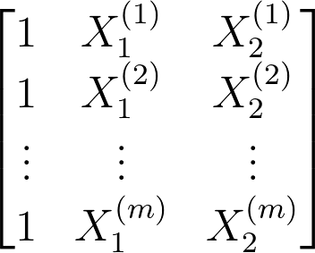
General overview
[[1, 40, 20],
[1, 20, 50],
...
[1, 5,
35]]

Slide 34
Code
freqs = build_freqs(tweets,labels) #Build frequencies dictionary
X = np.zeros((m,3)) #Initialize matrix X
for i in range(m): #For every tweet
p_tweet = process_tweet(tweets[i]) #Process tweet X[i,:] = extract_features(p_tweet,freqs) #Extract Features

Slide 35
Summary
Implement the feature extraction algorithm for your entire set of
tweets
Almost ready to train!

Slide 36






Overview of logistic regression
Parameters
F
Sigmoid
Cost
Output vs Label
Features
Output
Labels

Slide 37
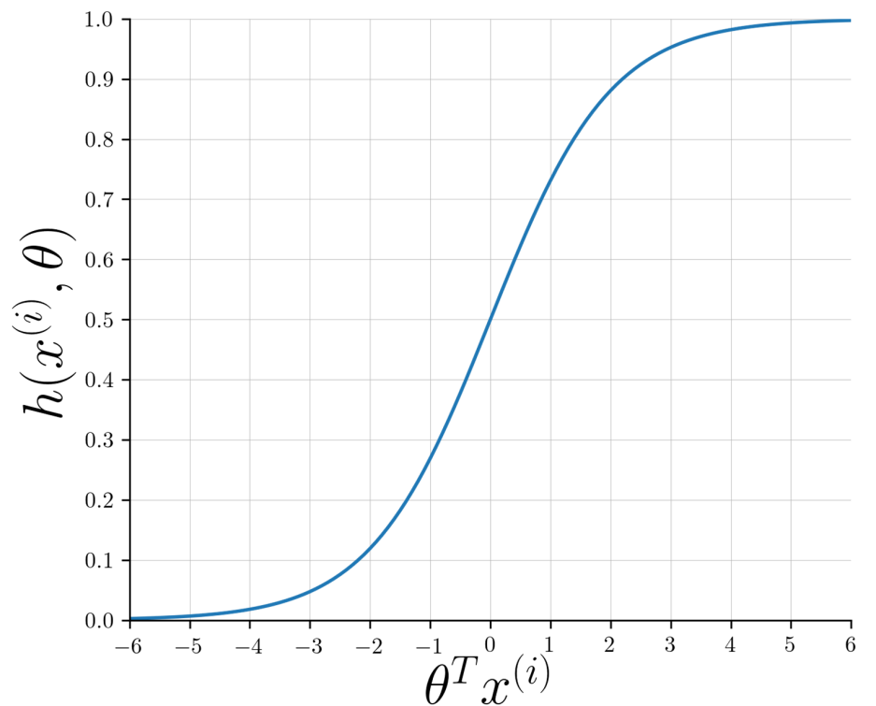

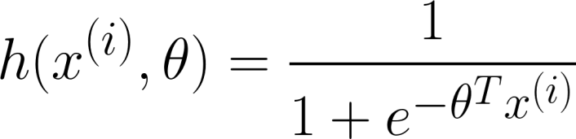

Overview of logistic regression

Slide 38
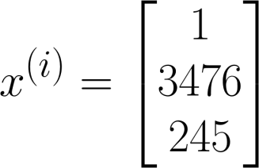
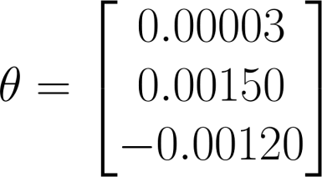

Overview of logistic regression
@YMourri and @AndrewYNg are tuning a GREAT AI model
4.92
[tun, ai, great, model]

Slide 39


Sigmoid Function
●
, positive
●
, negative

Slide 40
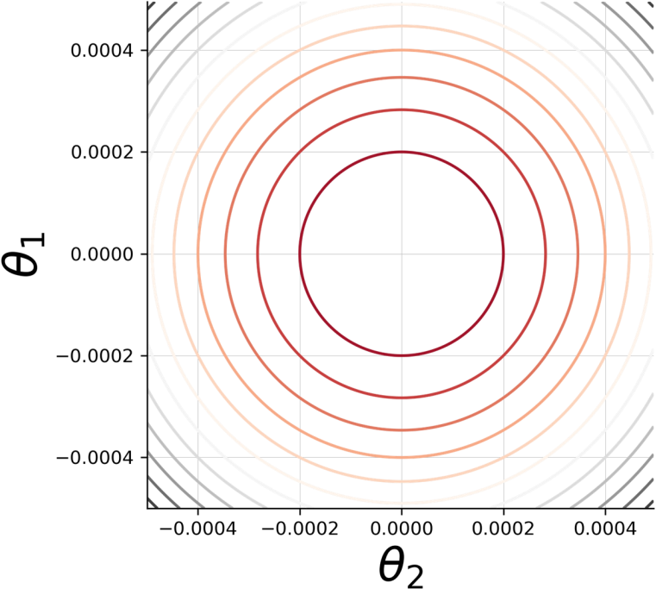
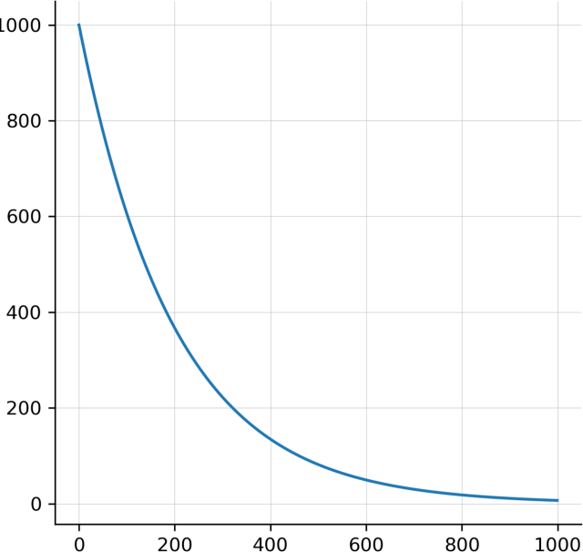
Training LR
Cost
Iteration

Slide 41

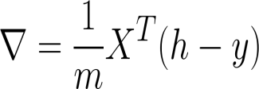


Training LR
Initialize
parameters
Classify/predict
Get gradient
Until good
enough
Update
Get Loss

Slide 42



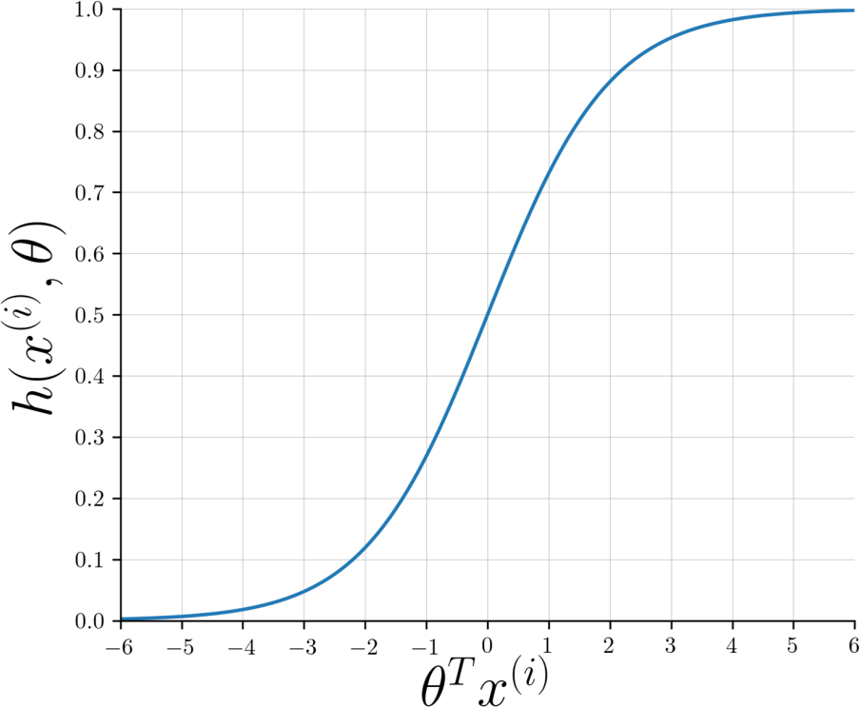






Testing Logistic Regression
●
,
,

Slide 43
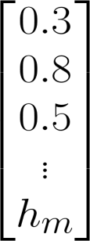
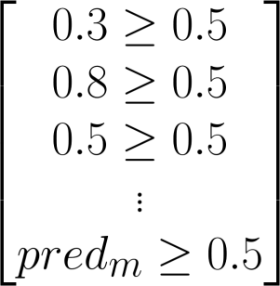
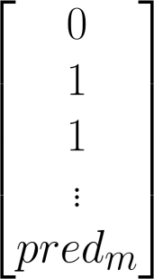

Testing Logistic Regression
●
,
,

Slide 44
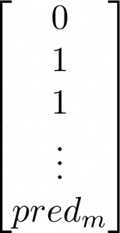
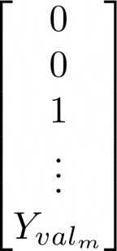
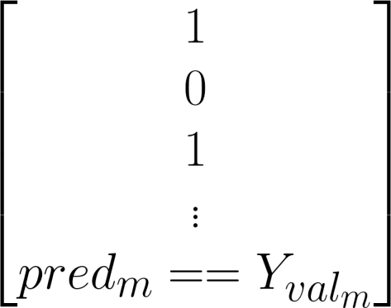
Testing Logistic Regression
●
,
,

Slide 45
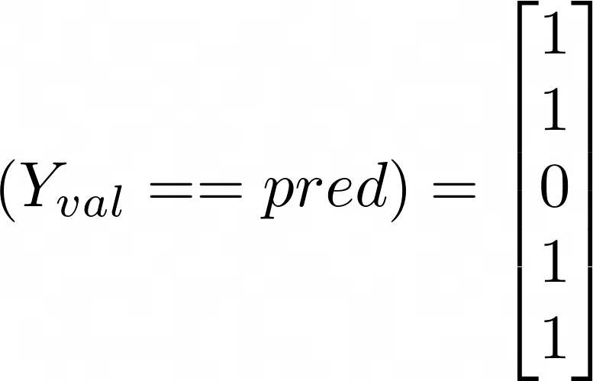
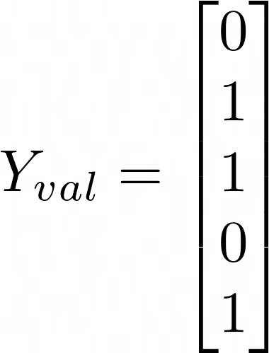
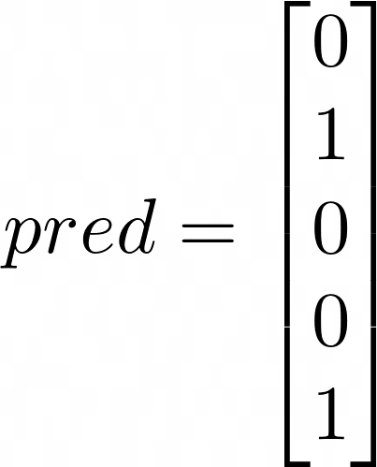
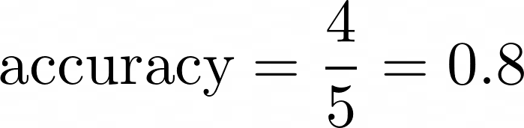
Testing Logistic Regression

Slide 46
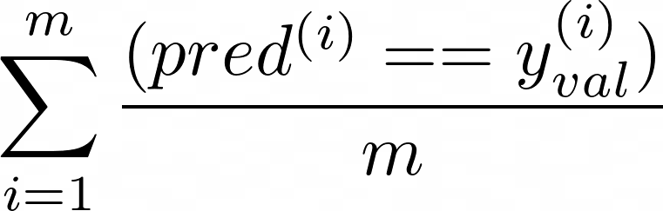
Summary
●
Performance on unseen data
Accuracy
To improve model: step size, number of iterations, regularization, new features, etc.

Slide 47
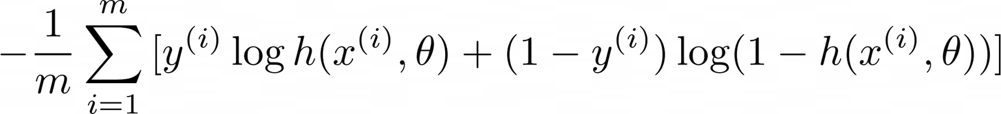

Cost Function for Logistic Regression

Slide 48
Cost Function for Logistic Regression

Slide 49


Cost Function for Logistic Regression
0 | any | 0
1 | 0.99 | ~0
1 | ~0 | -inf

Slide 50
Cost Function for Logistic Regression
1 | any | 0
0 | 0.01 | ~0
0 | ~1 | -inf

Slide 51
Cost Function for Logistic Regression

Slide 52
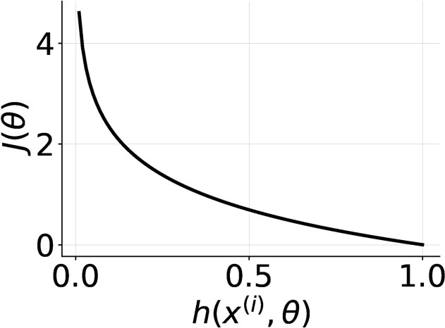
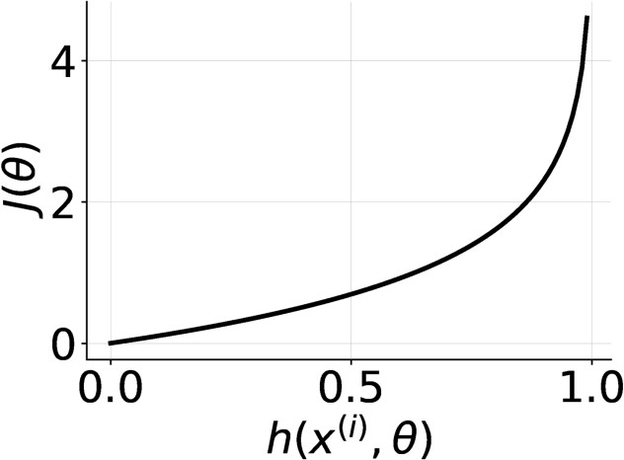
Cost Function for Logistic Regression

Slide 53
Cost Function for Logistic Regression
Strong disagreement = high cost
Strong agreement = low cost
Aim for the lowest cost!

Slide 54
Probability and Bayes’ Rule
Probabilities
Bayes’ rule (Applied in different fields, including NLP)
Build your own Naive-Bayes tweet classifier!

Slide 55
Probability
Tweets containing the word
“happy”
Corpus of tweets
 | P | ositive
 | Ne | gative
 |  | Positive
 |  | “hap | py”
 | Ne | gative

Slide 56
Probability
Corpus of tweets
A → Positive tweet
P(A) = P(Positive) = N_{pos} / N
Positive
Negative

Slide 57
Probability
Corpus of tweets
A → Positive tweet
P(A) = N_{pos} / N = 13 / 20 = 0.65
P(Negative) = 1 - P(Positive) = 0.35
Positive
Negative

Slide 58
Probability
Tweets containing the word
“happy”
B → tweet contains “happy”.
P(B) = P(happy) = N_{happy} / N
P(B) = 4 / 20 = 0.2
 | “hap | py”

Slide 59





Probability
 | Po | sitive
 |  | “happ | y”
Corpus
“happy”
“happy”
Positive
Positive

Slide 60
Bayes’ Rule
Corpus
“happy”
“happy”
Positive
Pos | itive | “happ | y”
P(A | B) = P(Positive | “happy”)
P(A | B) = 3 / 4 = 0.75

Slide 61
Bayes’ Rule
 | Po | sitive
“h | appy | ”
Corpus
“happy”
Positive
Positive
P(B | A) = P(“happy”| Positive)
P(B | A) = 3 / 13 = 0.231

Slide 62
Conditional Probabilities
Conditional Probabilities
Probability of B, given A happened
Looking at the elements of set A, the chance that one also belongs to set B

Slide 63



Conditional probabilities
Corpus
“happy”
“happy”
Positive
Positive

Slide 64
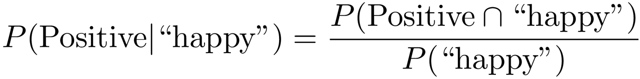
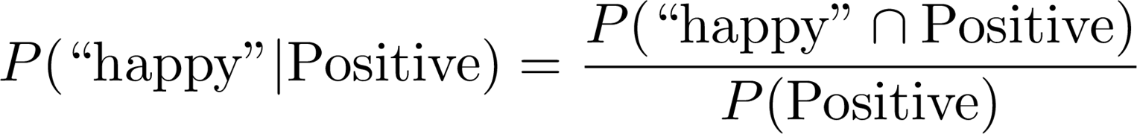
Bayes’ Rule

Slide 65
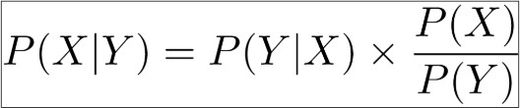
Bayes’ Rule
Quiz: Bayes’ Rule Applied
Objective: Compute conditional probability using Bayes Rule
Question:
Here, again, is Bayes’ rule:
Suppose that in your dataset, 25% of the positive tweets contain the word ‘happy’. You also know that a total of 13% of the tweets in your dataset contain the word 'happy', and that 40% of the total number of tweets are positive. You observe the tweet: ''happy to learn NLP'. What is the probability that this tweet is positive?
Type: Multiple Choice, single answer
Options and solution:
A: P(Positive | “happy” ) = 0.77 That’s right. You just applied Bayes’ rule.
B: P(Positive | “happy” ) = 0.08 Oops, looks like you might have the ratio of P(X) and P(Y) upside-down.
C: P(Positive | “happy” ) = 0.10 Remember to calculate the ratio in the formula for Bayes’ rule.
D: P(Positive | “happy” ) = 1.92 Did you use the probability of a tweet being positive? Remember that a fractional probability must be between 0 and 1.
Options and solution:
A: P(Positive | “happy” ) = 0.77
B: P(Positive | “happy” ) = 0.08
C: P(Positive | “happy” ) = 0.10
D: P(Positive | “happy” ) = 1.92

Slide 66
Naïve Bayes for Sentiment Analysis
word | Pos | Neg
I | 3 | 3
am | 3 | 3
happy | 2 | 1
because | 1 | 0
learning | 1 | 1
NLP | 1 | 1
sad | 1 | 2
not | 1 | 2
Positive tweets
Negative tweets
I am happy because I am learning NLP I am happy, not sad.
I am sad, I am not learning NLP
I am sad, not happy
^{N}class
13 12

Slide 67
Naïve Bayes for Sentiment Analysis
word | Pos | Neg
I | 3 | 3
am | 3 | 3
happy | 2 | 1
because | 1 | 0
learning | 1 | 1
NLP | 1 | 1
sad | 1 | 2
not | 1 | 2
Positive tweets
Negative tweets
I am happy because I am learning NLP I am happy, not sad.
I am sad, I am not learning NLP
I am sad, not happy
^{N}class
13 12

Slide 68
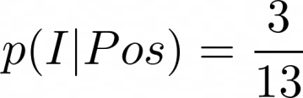
P(w_{i} | class)
Naïve Bayes for Sentiment Analysis
word Pos
Neg
3
word
Pos Neg
3
am 3
happy 2
because 1
learning 1
NLP 1
sad 1
not 1
I
I 0.24 0.25
am 0.24 0.25
happy 0.15 0.08
because 0.08 0.00
learning 0.08 0.08
NLP 0.08 0.08
sad 0.08 0.08
not 0.08 0.17
3
1
0
1
1
2
2
Nclass
13
12
Sum 1
1

Slide 69
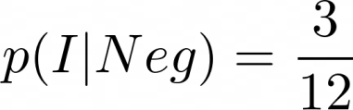
P(w_{i} | class)
Naïve Bayes for Sentiment Analysis
word Pos
Neg
3
word
Pos Neg
3
am 3
happy 2
because 1
learning 1
NLP 1
sad 1
not 1
I
I 0.24 0.25
am 0.24 0.25
happy 0.15 0.08
because 0.08 0.00
learning 0.08 0.08
NLP 0.08 0.08
sad 0.08 0.08
not 0.08 0.17
3
1
0
1
1
2
2
Nclass
13
12
Sum 1
1

Slide 70
Naïve Bayes for Sentiment Analysis
We might get P(w_{i}|class) = 0 for some words. We will talk about this in a bit.
word
Pos Neg
I 0.24 0.25
am 0.24 0.25
happy 0.15 0.08
because 0.08 0.00
learning 0.08 0.08
NLP 0.08 0.08
sad 0.08 0.08
not 0.08 0.17
Sum 1
1

Slide 71
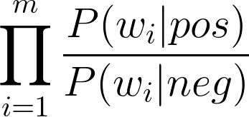
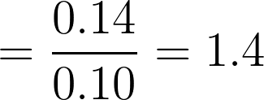
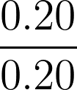
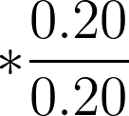
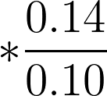
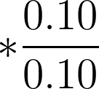
Naïve Bayes
Tweet: I am happy today; I am learning.
word
Pos Neg
I | 0.20 | 0.20
am | 0.20 | 0.20
> 1
happy
0.14 0.10
because
0.10 0.05
learning
0.10 0.10
NLP 0.10 0.10
sad 0.10 0.10
not 0.10 0.15

Slide 72
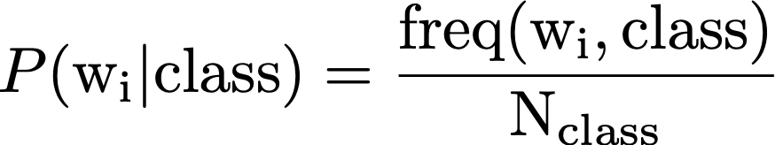
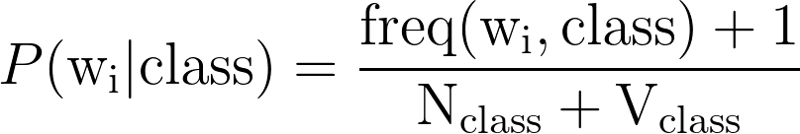
Laplacian Smoothing
class ∈ {Positive, Negative}
N_{class} = frequency of all words in class V_{class} = number of unique words in class

Slide 73
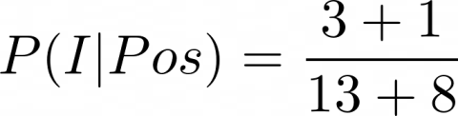
Introducing P(w_{i} | class) with smoothing
word | Pos | Neg |  | word | Pos | Neg
I | 3 | 3
am | 3 | 3
happy | 2 | 1
I 0.19 0.20
am 0.19 0.20
happy 0.14 0.10
because 0.10 0.05
learning 0.10 0.10
NLP 0.10 0.10
sad 0.10 0.10
not 0.10 0.15
because | 1 | 0
learning | 1 |  | 1
NLP | 1 |  | 1
sad | 1 |  | 2
not | 1 |  | 2
Nclass | 13
V = 8
12
Sum 1
1
Laplacian Smoothing

Slide 74
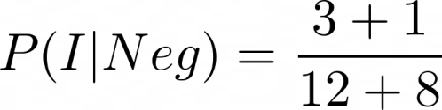
Introducing P(w_{i} | class) with smoothing
word | Pos | Neg |  | word | Pos | Neg
I | 3 | 3
am | 3 | 3
happy | 2 | 1
I 0.19 0.20
am 0.19 0.20
happy 0.14 0.10
because 0.10 0.05
learning 0.10 0.10
NLP 0.10 0.10
sad 0.10 0.10
not 0.10 0.15
because | 1 | 0
learning | 1 |  | 1
NLP | 1 |  | 1
sad | 1 |  | 2
not | 1 |  | 2
Nclass | 13
V = 8
12
Sum 1
1
Laplacian Smoothing

Slide 75
Summary
Laplacian smoothing to avoid P(w_{i}|class) = 0
Naïve Bayes formula

Slide 76

Ratio of probabilities
Positive
word Pos Neg
I 0.19 0.20
ratio
1
P(w_{i} | Pos)
am 0.19 0.20
1
ratio(w_{i}) =
P(w_{i} | Neg)
1
happy
0.14 0.10
1.4
Neutral
because
0.10 0.05
1
1
1
learning
0.10 0.10
freq(w_{i} , 1) + 1
NLP 0.10 0.10
Negative
0
sad 0.10 0.15
0.6
freq(w_{i} , 0) + 1
not 0.10 0.15 0.6

Slide 77
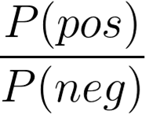
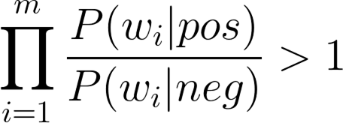
Naïve Bayes’ inference
class ∈ {pos, neg}
w -> Set of m words in a tweet
A simple, fast, and powerful baseline
A probabilistic model used for classification

Slide 78
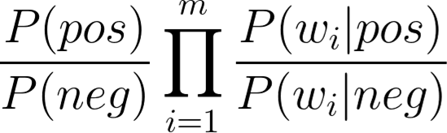





Log Likelihood
Products bring risk of underflow
●
●
log prior +
log likelihood

Slide 79




Calculating Lambda
tweet: I am happy because I am
learning.
word
Pos Neg 𝝀
I 0.05 0.05
0
0
2.2
0
0
1.1
-2.2
-0.4
am 0.04 0.04
happy 0.09 0.01
0.01
0.01
0.02
0.09
0.03
because 0.01
learning 0.03
NLP 0.02
sad 0.01
not 0.02

Slide 80

Calculating Lambda
tweet: I am happy because I am
learning.
word
Pos Neg 𝝀
I 0.05 0.05
0
0
2.2
0
0
1.1
-2.2
-0.4
am 0.04 0.04
happy 0.09 0.01
0.01
0.01
0.02
0.09
0.03
because 0.01
learning 0.03
NLP 0.02
sad 0.01
not 0.02

Slide 81

Summing the Lambdas
doc: I am happy because I am learning.
word
Pos Neg 𝝀
 | I | 0.05 | 0.05 | 0
 | am | 0.04 | 0.04 | 0
 | happy | 0.09 | 0.01
2.2
0
1.1
0
-2.2
-0.4
because | 0.01 | 0.01
learning | 0.03 | 0.01
NLP | 0.02 | 0.02
sad | 0.01 | 0.09
not | 0.02 | 0.03

Slide 82


Summing the Lambdas
doc:
I | am | happy | because |  | I am | learning.
word Pos Neg 𝝀
I 0.05 0.05 0
am 0.04 0.04 0
happy 0.09 0.01 2.2
because 0.01 0.01 0
learning 0.03 0.01 1.1
NLP 0.02 0.02 0
sad 0.01 0.09 -2.2
not 0.02 0.03 -0.4
+ + + + + =
0 2.2 0 0 0 1.1 3.3
log likelihood = 0 ⁺

Slide 83




Log Likelihood
0
1
> 1
Negative
Neutral
Positive
3.3 > 0
0
-
> 0
Negative
Neutral
Positive

Slide 84

Summary
Positive
Tweet sentiment:
Neutral
0
> 0
Negative
-

Slide 85
Training Naïve Bayes
Five steps for training a Naïve Bayes model

Slide 86
Training Naïve Bayes
Lowercase
Remove punctuation, urls, names
Remove stop words
Stemming
Tokenize sentences
Step 1: Collect and annotate corpus
Positive tweets
Negative tweets
Positive tweets
Negative tweets
I am happy because I am learning NLP
I am happy, not sad. @NLP
[happi, because, learn, NLP] [happi, not, sad]
Step 2: Preprocess
[sad, not, learn, NLP]
[sad, not, happi]
I am sad, I am not learning NLP
I am sad, not happy!!

Slide 87
Training Naïve Bayes
freq(w, class)
word Pos Neg
happi 2 1
because 1 0
learn 1 1
NLP 1 1
sad 1 2
not 1 2
Positive tweets
Negative tweets
[happi, because, learn, NLP] [happi, not, sad]
Step 3: Word count
[sad, not, learn, NLP]
[sad, not, happi]
^{N}class
7
7

Slide 88




Training Naïve Bayes
Step 4: Get lambda
freq(w, class)
word Pos Neg
happi 2 1
because 1 0
learn 1 1
NLP 1 1
sad 1 2
not 1 2
word Pos Neg 𝝀
happy 0.23 0.15 0.43
because 0.15 0.07 0.6
learning 0.08 0.08 0
NLP 0.08 0.08 0
sad 0.08 0.17 -0.75
not 0.08 0.17 -0.75
Step 4:
^{N}class
7
7

Slide 89


Training Naïve Bayes
D_{pos} = Number of positive tweets D_{neg} = Number of negative tweets
Step 5:
Get the
log prior
If dataset is balanced, D_{pos} = D_{neg} and logprior = 0.

Slide 90
Summary
Get or annotate a dataset with positive and negative tweets
Preprocess the tweets: process_tweet(tweet) ➞ [w₁, w₂, w₃, ...]
Compute freq(w, class)
Get P(w | pos), P(w | neg)
Get λ(w)
Compute logprior = log(P(pos) / P(neg))

Slide 91






Predict using Naïve Bayes
log-likelihood dictionary
word 𝝀
I -0.01
the -0.01
happi 0.63
because 0.01
pass 0.5
NLP 0
sad -0.75
not -0.75
Tweet: [I, pass, the, NLP, interview]
● Tweet: I passed the NLP interview.
> 0

Slide 92










Predict using Naïve Bayes
●
, ,
=
=

Slide 93

Predict using Naïve Bayes
●
, ,

Slide 94
Predict using Naïve Bayes
●
Performance on unseen data
Predict using
and
for each new tweet
Accuracy
What about words that do not appear in λ(w)?

Slide 95


Applications of Naïve Bayes

Slide 96




Applications of Naïve Bayes
Author identification:
Spam filtering:
"Icon made by Vector Market from www.flaticon.com"

Slide 97

Applications of Naïve Bayes
Information retrieval:
Retrieve document if

Slide 98



Applications of Naïve Bayes
Word disambiguation:
Bank:
"Pictures with CC"

Slide 99
Applications of Naïve Bayes
Sentiment analysis
Author identification
Information retrieval
Word disambiguation
Simple, fast and robust!
"Pictures with CC"

Slide 100

Naïve Bayes Assumptions
Independence
“It is sunny and hot in the Sahara desert.”

Slide 101

Naïve Bayes Assumptions
“It’s always cold and snowy in .”
spring?? summer? fall?? winter??

Slide 102

Naïve Bayes Assumptions
Relative frequencies in corpus

Slide 103
Summary
Independence: Not true in NLP
Relative frequency of classes affect the model

Slide 104
Error Analysis
Removing punctuation and stop words
Word order
Adversarial attacks

Slide 105
Processing as a Source of Errors: Punctuation
Tweet: My beloved grandmotherX:(
processed_tweet: [belov, grandmoth]

Slide 106
Processing as a Source of Errors: Removing Words
Tweet: This is not good, because your attitude is not even close to being nice.
processed_tweet: [good, attitude, close, nice]

Slide 107


Processing as a Source of Errors: Word Order
Tweet: I am happy because I do not go.
Tweet: I am not happy because I did go.

Slide 108
Adversarial attacks
Sarcasm, Irony and Euphemisms
Tweet: This is a ridiculously powerful movie. The plot was gripping and I cried right through until the ending!
processed_tweet: [ridicul, power, movi, plot, grip, cry, end]

Slide 109
Summary
Removing punctuation
Removing words
Word order
Adversarial attacks

Slide 110
References
These slides have been adapted from
Younes Mourri & Lukasz Kaiser, Natural Language Processcing Specialization, DeepLearning.Ai
Dan Klein, Natural Language Processing, UC Berkeley

